Slide 1
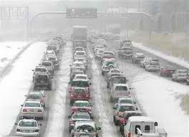
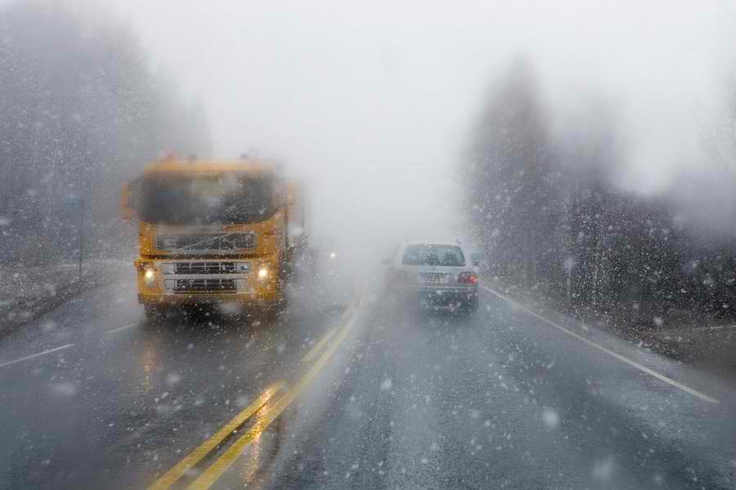
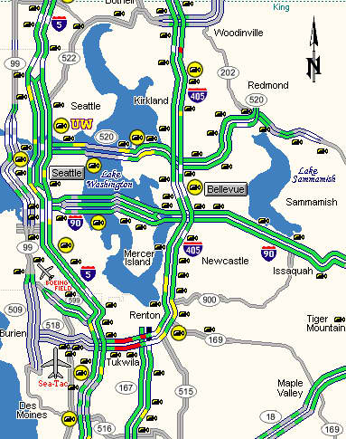
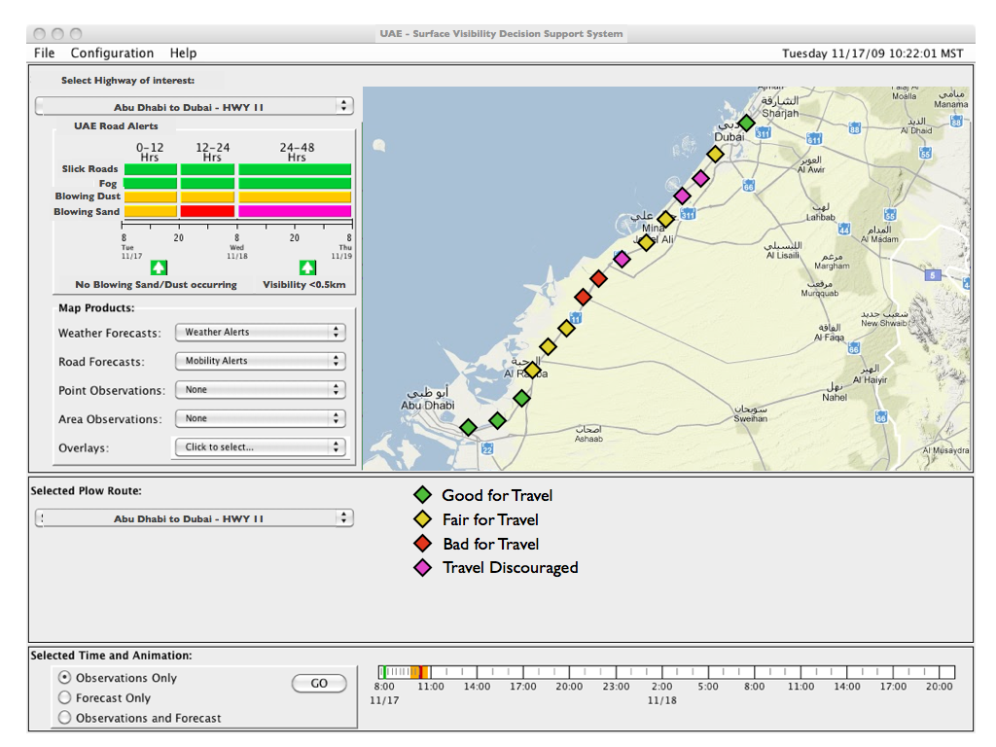
Road Weather Research
Mike Chapman – mchapman@ucar.edu
NCAR – Research Applications Lab
Boulder, CO

Slide 2
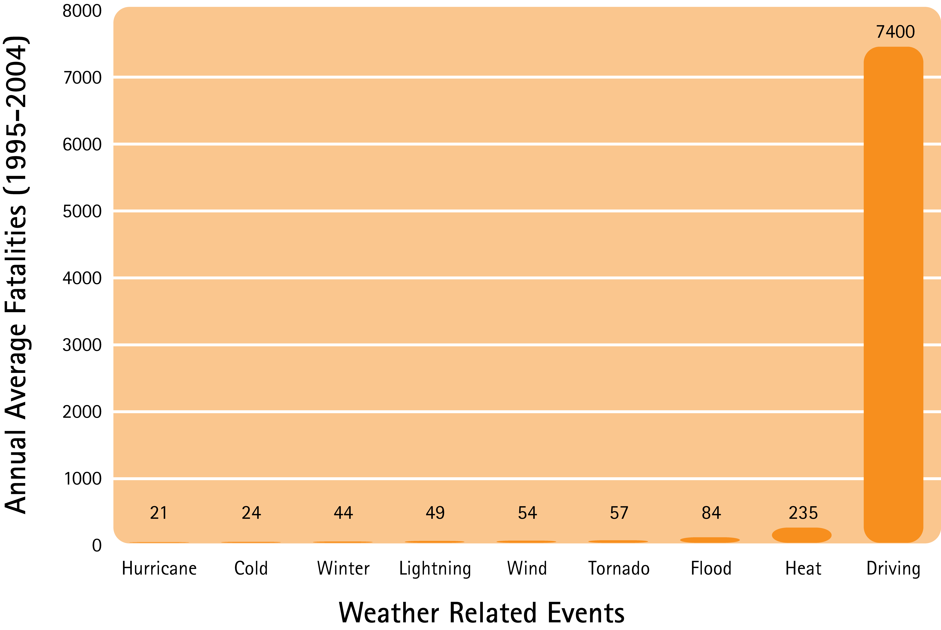
Why Invest in Road Weather Research
Safety
Over 1,500,000 crashes occur each year during poor weather conditions, which result in more than 690,000 people injured and nearly 7,400 fatalities.*
Efficiency and Mobility
It is estimated that 554 million vehicle-hours of delay per year result from snow, ice, and fog at an approximate cost of $8 billion.

Slide 3
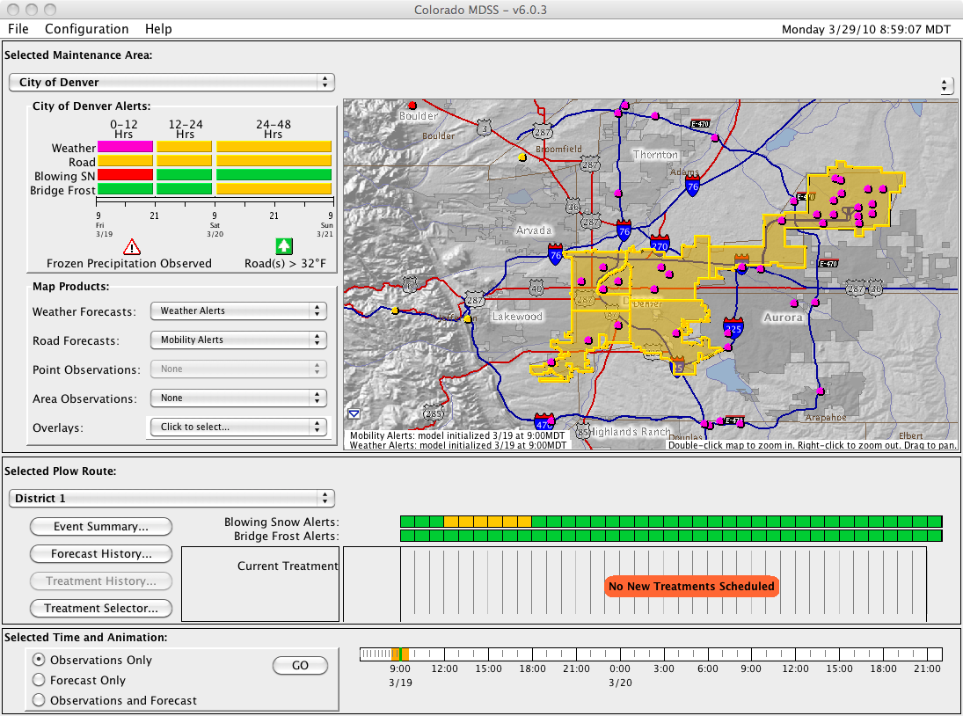
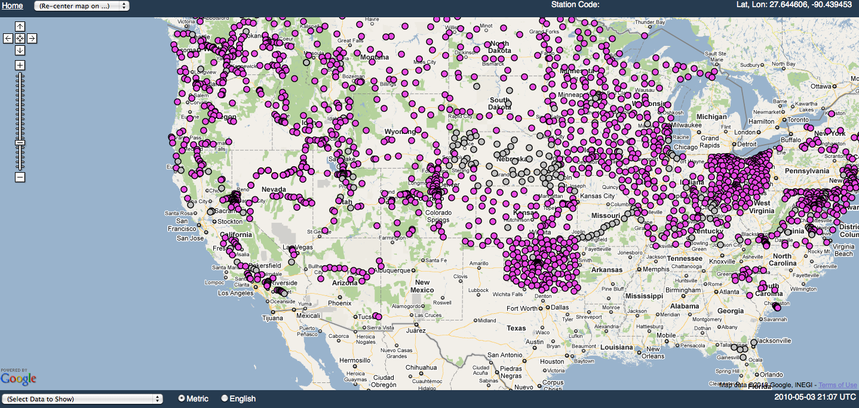
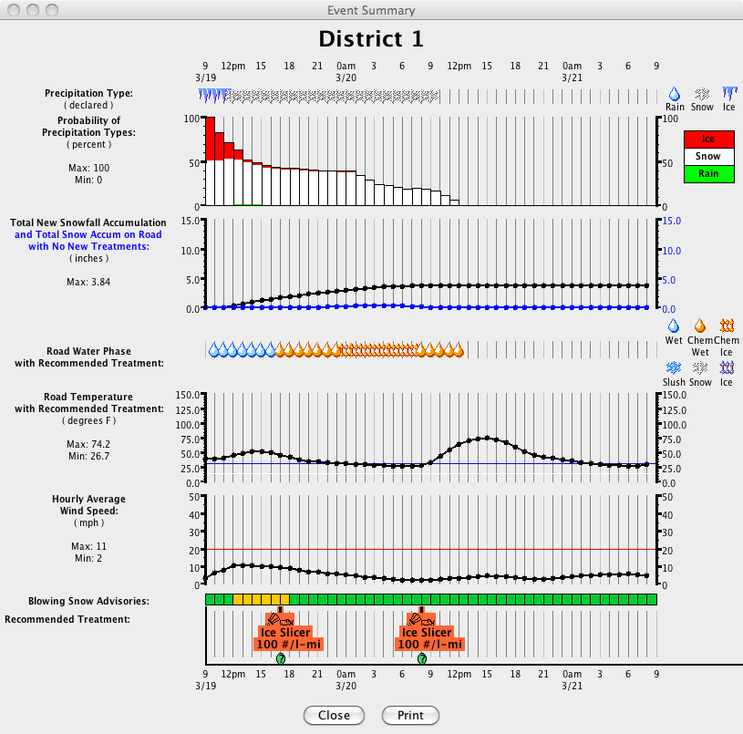
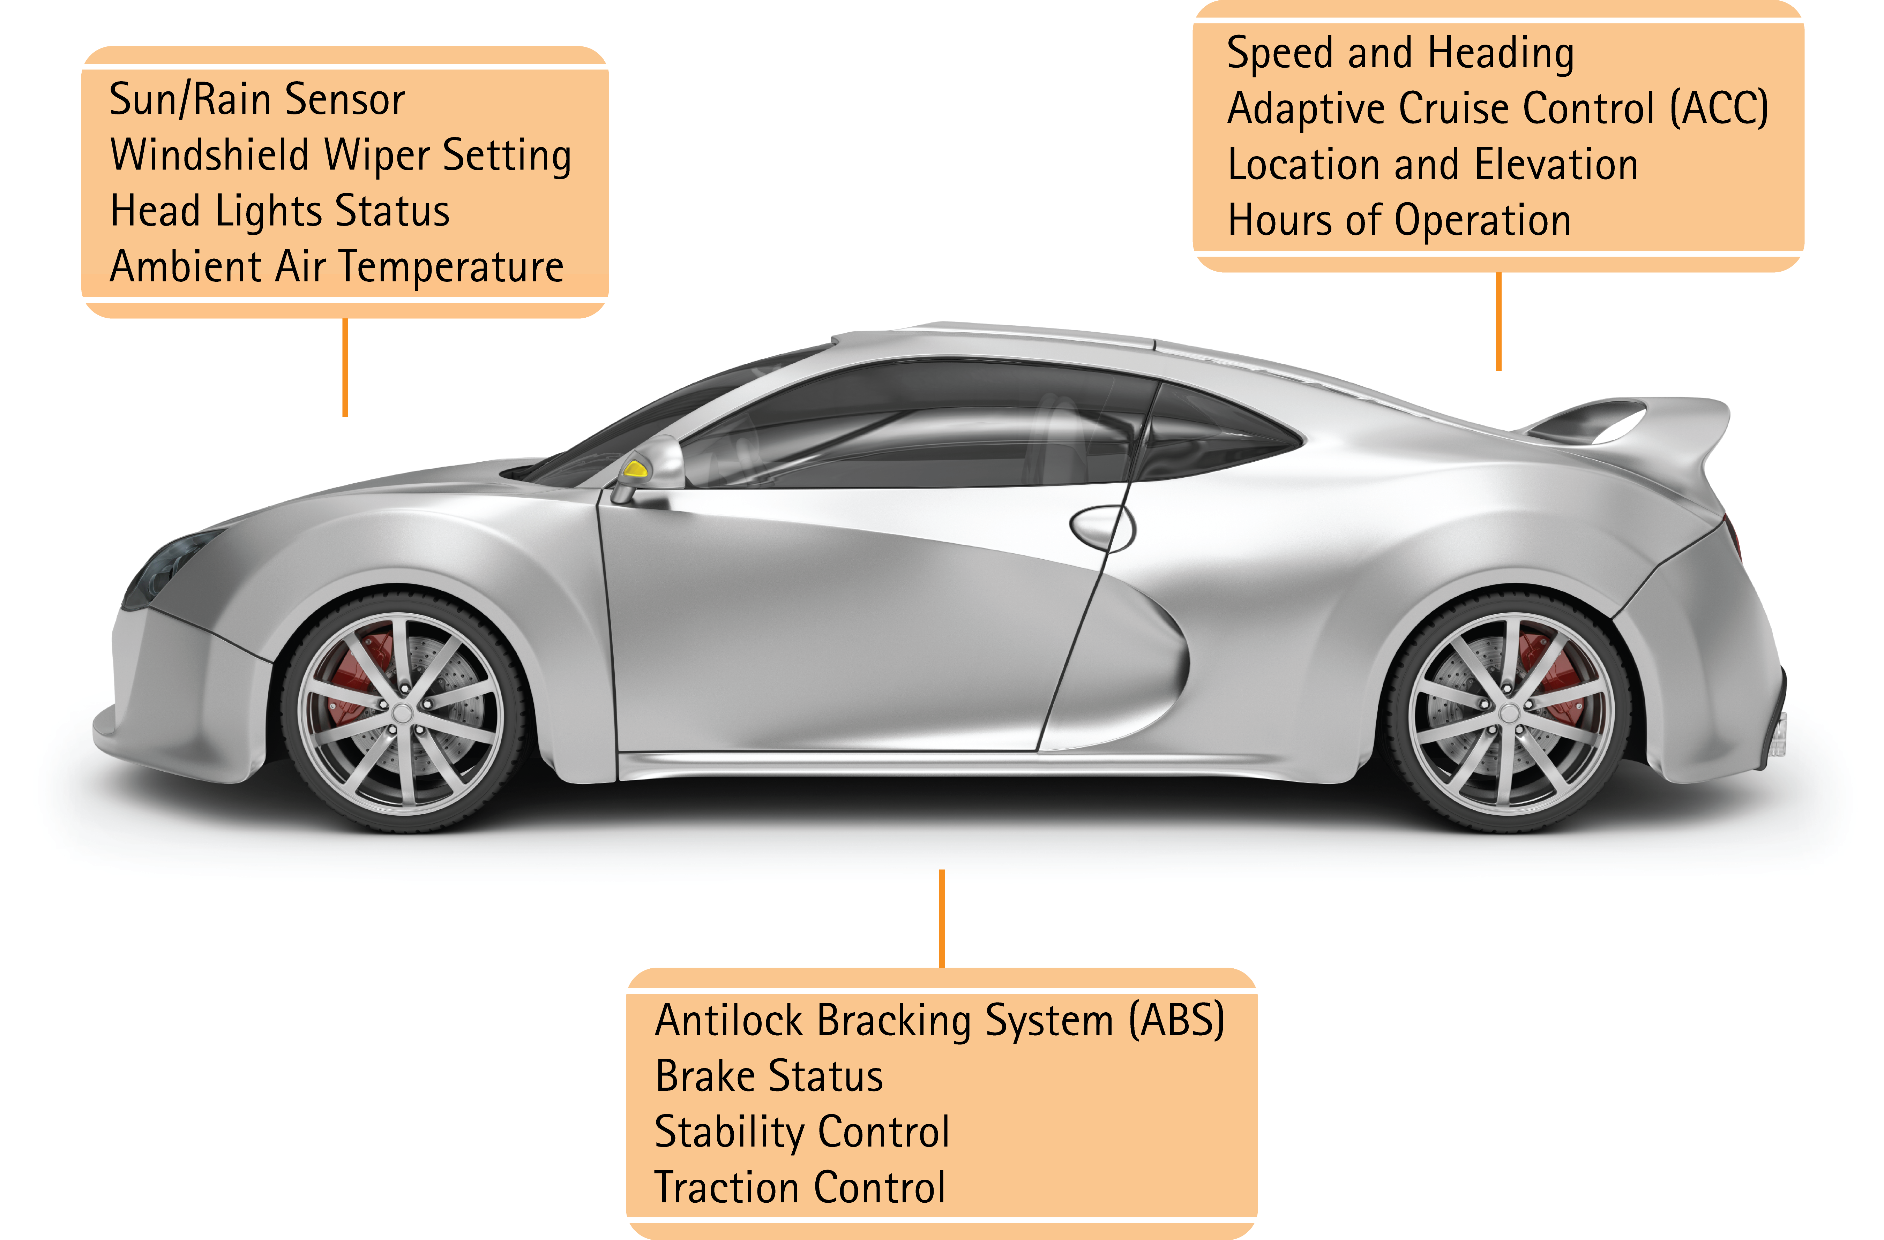
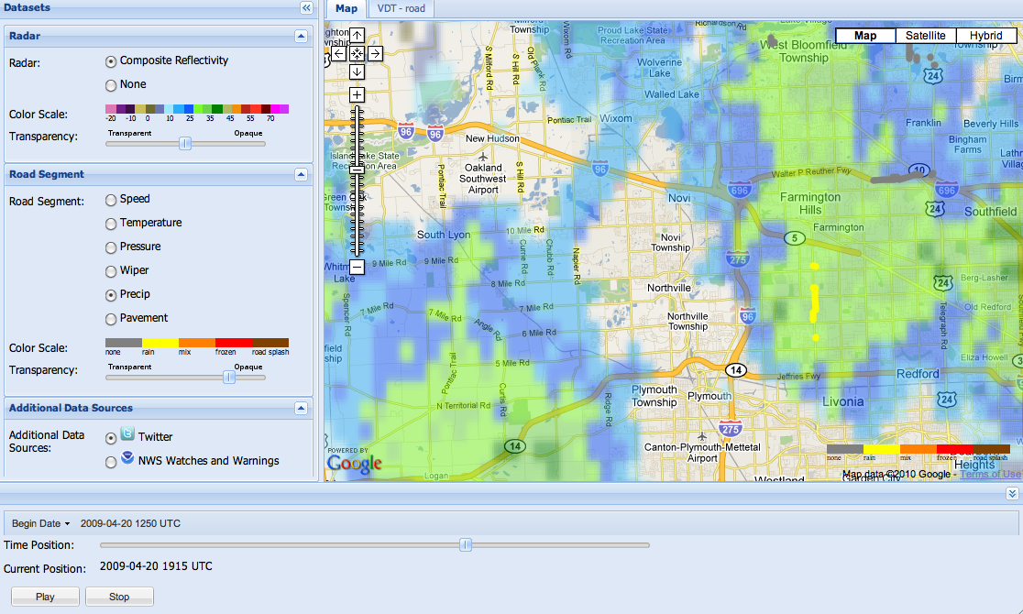
Current Solutions
Maintenance Decision Support System - MDSS
Clarus System
IntellidriveSM-enabled Weather

Slide 4
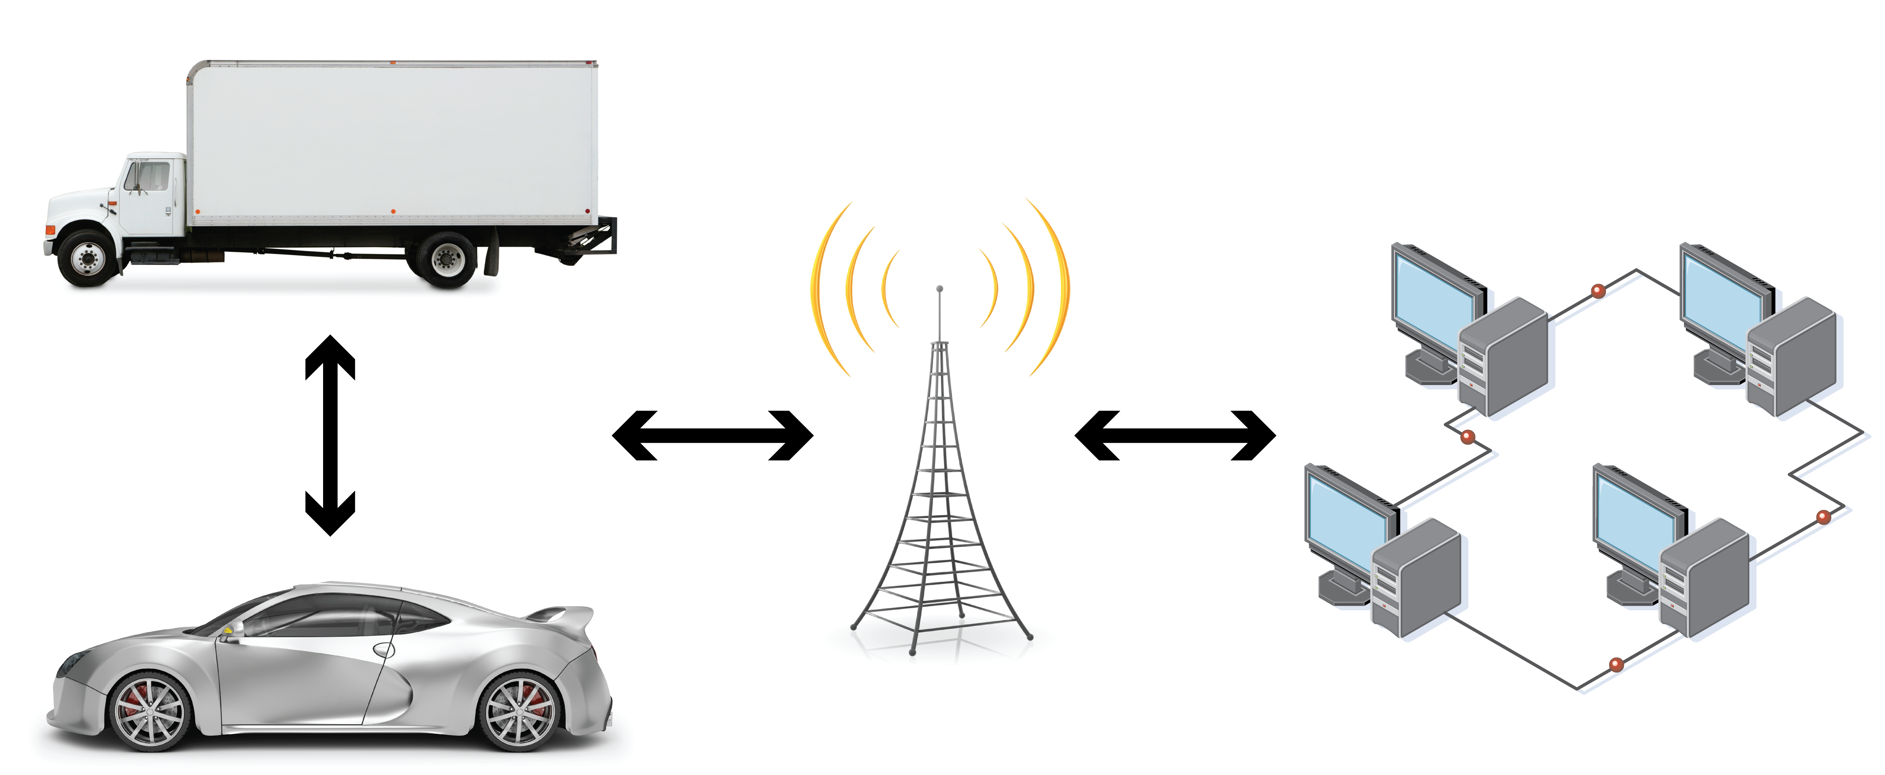
Weather Observations from Connected Vehicles

Slide 5
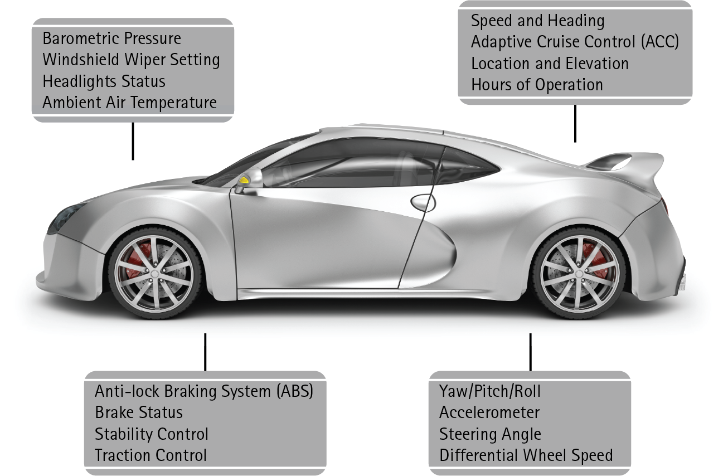
Weather Observations from Connected Vehicles

Slide 6
Vehicle Data Translator (VDT) – Version 3.0
Objectives
Better Characterization of current weather and road-weather conditions
Accurate Quality Checking and/or Quality Control of vehicle data
Development of inferred road segment specific weather and road-weather information for end-user applications

Slide 7
Vehicle Data Translator (VDT) – Version 3.0
Ancillary: Radar, Satellite, RWIS, Etc.
VDT 3.0
Stage I
Stage II
Stage III
Mobile data ingesters
Ancillary data ingesters
Statistics module
Inference Module
Output data handler
QCh Module
Output data handler
Output data handler
Parsed mobile data
Qched data, Basic road segment data
Advanced road segment data
Apps

Slide 8
Vehicle Data Translator (VDT) – Version 3.0
Ancillary: Radar, Satellite, RWIS, Etc.
VDT 3.0
Stage I
Stage II
Stage III
Mobile data ingesters
Ancillary data ingesters
Statistics module
Inference Module
Output data handler
QCh Module
Output data handler
Output data handler
Parsed mobile data
Qched data, Basic road segment data
Advanced road segment data
Apps

Slide 9
Vehicle Data Translator (VDT) – Version 3.0
Stage I
Ingest vehicle data from CANBus & aftermarket sensors
Data parsed, sorted/binned
Light Quality Control
Sorted by time, road segment and grid cell
Segments & grids user defined
All processed data available for other applications
Mobile data ingesters
Output data handler
Parsed mobile data
Apps

Slide 10
Vehicle Data Translator (VDT) – Version 3.0
Ancillary: Radar, Satellite, RWIS, Etc.
VDT 3.0
Stage I
Stage II
Stage III
Mobile data ingesters
Ancillary data ingesters
Statistics module
Inference Module
Output data handler
QCh Module
Output data handler
Output data handler
Parsed mobile data
Qched data, Basic road segment data
Advanced road segment data
Apps

Slide 11
Vehicle Data Translator (VDT) – Version 3.0
Ingest ancillary data for QC and Stage III
Quality Checks
From Clarus: Sensor Range, Spatial, Climate Range
New Mobile Data Tests: Data Filtering (tunnel, slow speeds), Model Analysis, Neighboring Vehicle, Combined Algorithm
Combines point data into basic road segment products
Temp range, speed, etc
Ancillary: Radar, Satellite, RWIS, Etc.
Stage II
Ancillary data ingesters
Statistics module
QCh Module
Output data handler
QC’d data, Basic road segment data
Apps

Slide 12
Vehicle Data Translator (VDT) – Version 3.0
Ancillary: Radar, Satellite, RWIS, Etc.
VDT 3.0
Stage I
Stage II
Stage III
Mobile data ingesters
Ancillary data ingesters
Statistics module
Inference Module
Output data handler
QCh Module
Output data handler
Output data handler
Parsed mobile data
Qched data, Basic road segment data
Advanced road segment data
Apps

Slide 13
Vehicle Data Translator (VDT) – Version 3.0
More sophisticated road impact information
Precipitation Type and Intensity: combines basic vehicle (e.g. wiper, temp), weather radar and satellite data
Visibility: combines basic vehicle (e.g. headlight, wiper, temp), satellite and fixed weather station data
Pavement Condition: combines more vehicle (e.g. ABS, traction, etc) , weather radar and satellite
Stage III
Inference Module
Output data handler
Advanced road segment data
Apps

Slide 14
Integrated Mobile Observations (IMO) Project
Solicitation for Partnership with States
NCAR issued the solicitation last fall (2010)
Scope of Work
Funding assistance / Grant
Pool Funds and Consortia were targeted: Aurora, IntelliDrive, Clear Roads, MDSS
Just a handful of states expressed interest:
Idaho
Minnesota
Nevada
South Dakota

Slide 15
Integrated Mobile Observations (IMO) Project
Selection based on
Fleet
Maturity of the maintenance ITS program
Integration of mobile obs into state’s application – MMS, MDSS, MODSS, TIS….
Other factors/synergies (multi-state, corridor, etc.)
Willingness to make data and lessons learned widely available /open source

Slide 16
Integrated Mobile Observations (IMO) Project
Selected States
Minnesota
Nevada

Slide 17
Integrated Mobile Observations (IMO) Project
Selected States
Minnesota
Nevada and Utah

Slide 18
Integrated Mobile Observations (IMO) Project
Nevada
Why
Actively pursuing an AVL/MDSS program
Fleet adds variety to the study (different manufacturer)
Strong upper management support
Strong proposal
Potential corridor-wide participation (I-80 corridor)
Strong partnership with academia (Univ. Nevada-Reno)
Proposed integration with MDSS, MMS, TIS
Ability to collect desired data parameters (from CAN-Bus and add-on sensors)
Level of Funding: $263K granted via an allocation memo

Slide 19
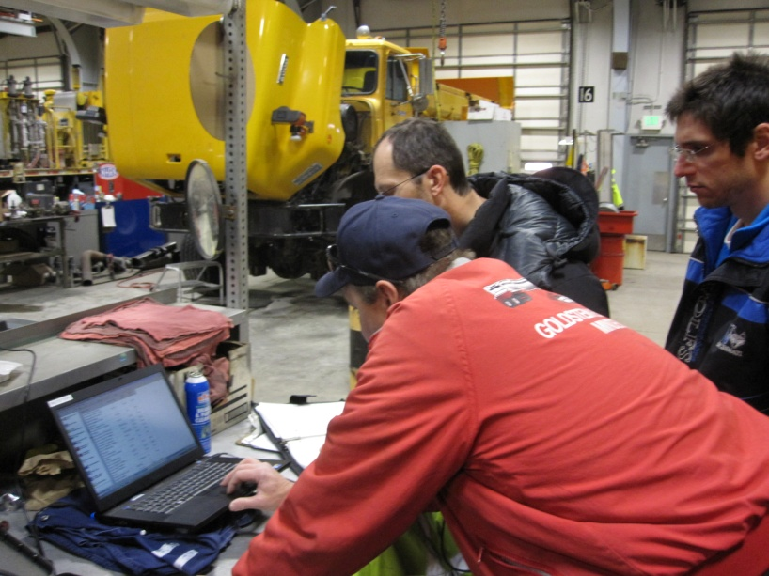
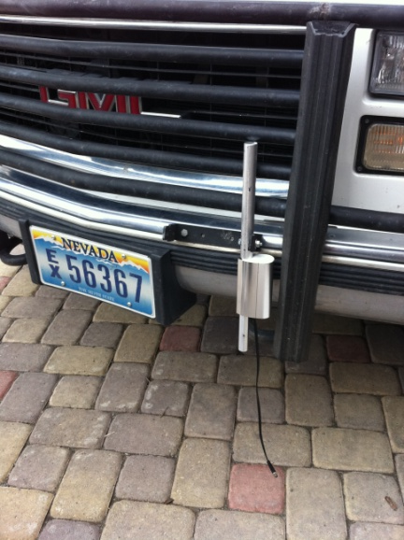
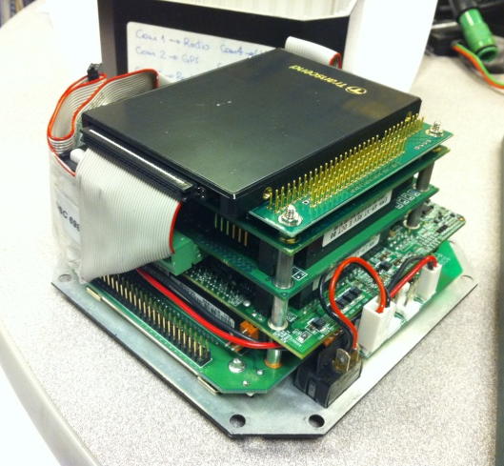
Various Weather & MDSS Data Parameters
Numerous sensors and devices are controlled or monitored by a vehicle-mounted computer.
Data is logged in-vehicle as well as sent via radio to UNR in near-real-time using the NDOT EDACS radio network.
All instrument and equipment installations are being done by UNR &NDOT teams who are familiar with the vehicles (NDOT) and instrumentation (UNR).
Collaborative NDOT & UNR Installation teams
Road and weather sensors
In-vehicle computer

Slide 20
Data Being Gathered NV IMO Project (UNR/NDOT)
General Data
GPS Date, time, location, bearing, speed, altitude, accuracy
Road Conditions
Road surface temperature
Vehicle accelerations (surface friction)
Road condition images (camera)
Atmospheric Conditions
Pressure, temperature, relative humidity, dew point
Wind speed and direction
Vehicle & Equipment Data
Speed, brake status, engine intake air temperature & pressure
Spreader and plow status
Steering, traction control, ABS, yaw, accelerations, emissions data, engine data, headlight and wiper status
Blue denotes parameter being implemented
Gray denotes parameter “under study”

Slide 21
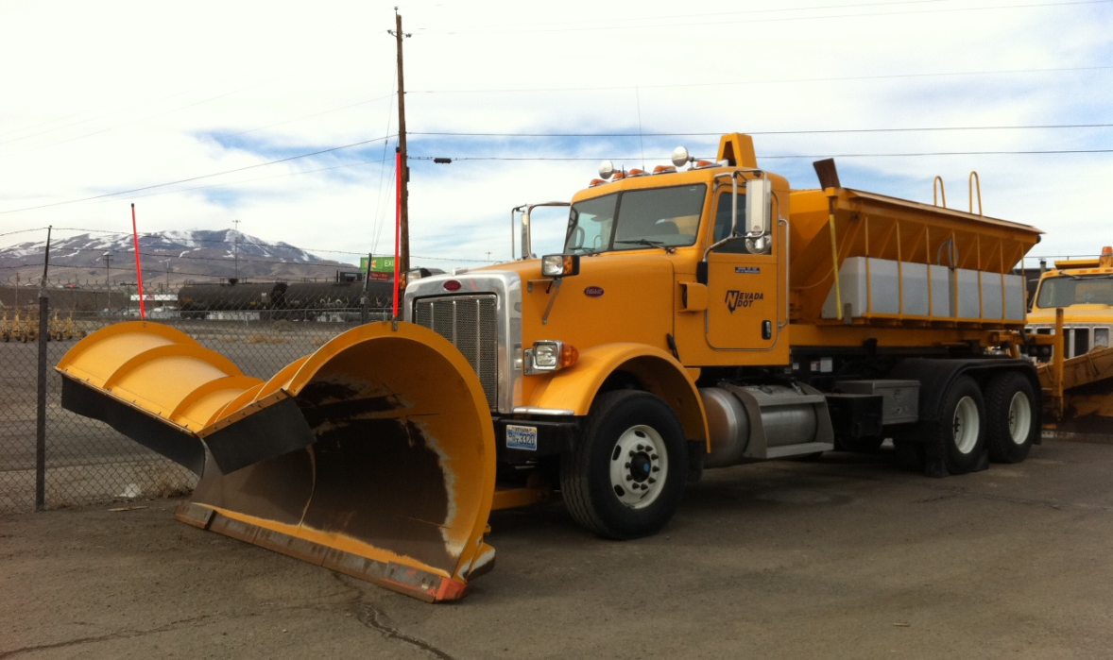
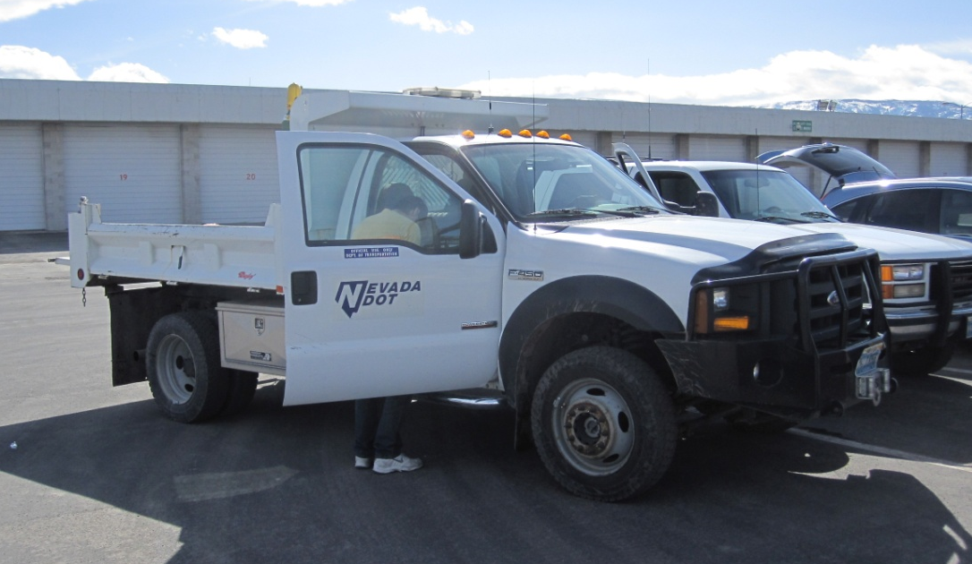
Two Vehicle Types Based in NV Districts 2 & 3 Along I-80 Corridor
Snowplows
Light Duty Vehicles (Crew, general purpose)
Vehicles with winter assignments along I-80 were selected.
Makes & models are presently limited to vehicles with compatible CANBus or OBDII vehicle data formats.

Slide 22
Integrated Mobile Observations (IMO) Project
Research and Applications
VDT 3.0 Algorithm development
Possible Input to MDSS, MMS, TIS
Assimilation into pavement model

Slide 23
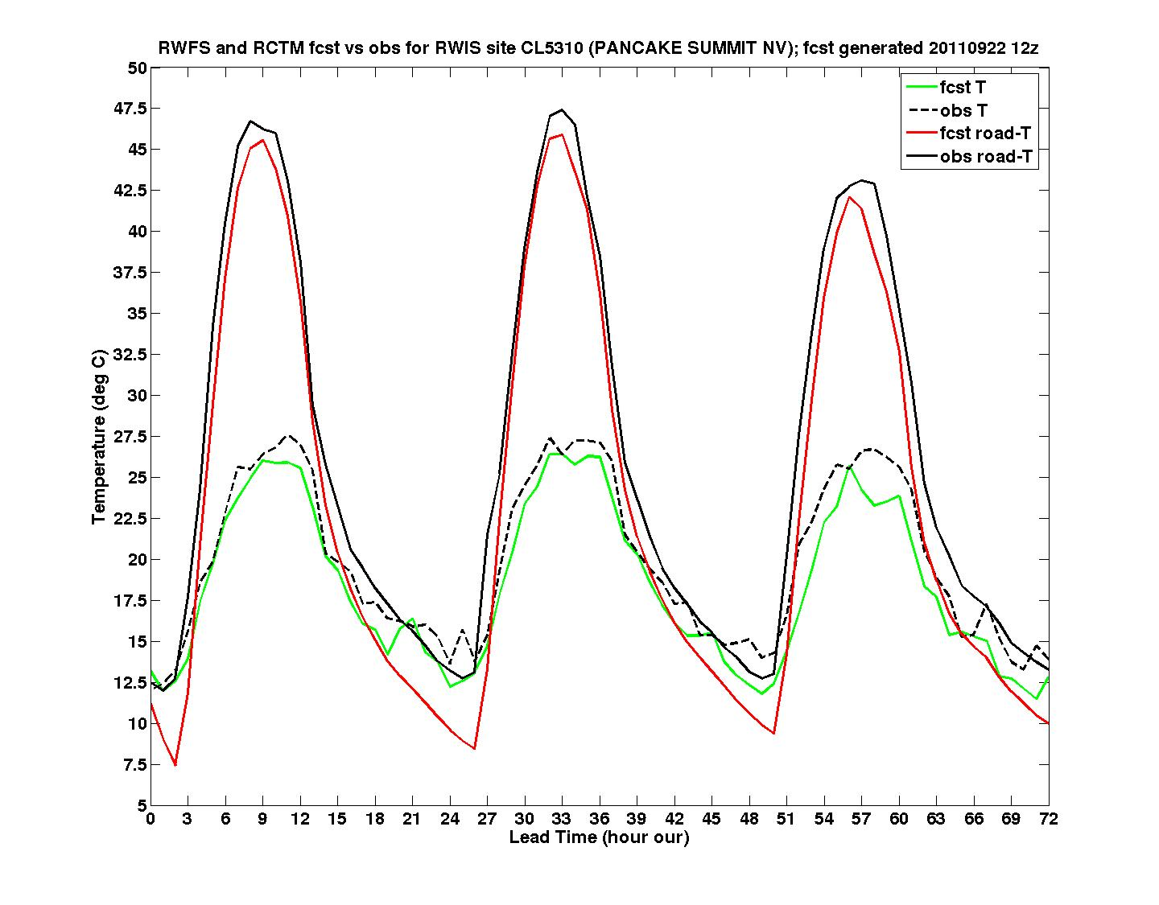
APPLICATIONS – IMO Project
Pancake Summit – 22 September 2011 1200UTC

Slide 24
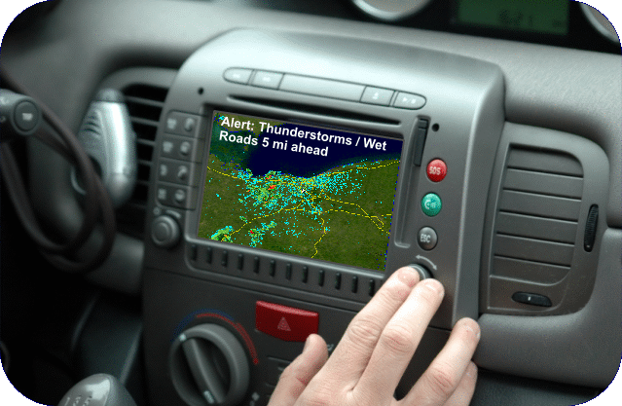
FUTURE APPLICATIONS
VDT-based weather alerts
Impending weather hazards
Alerts from other vehicles
Re-routing
Decision support
Not just for the everyday driver!

Slide 25
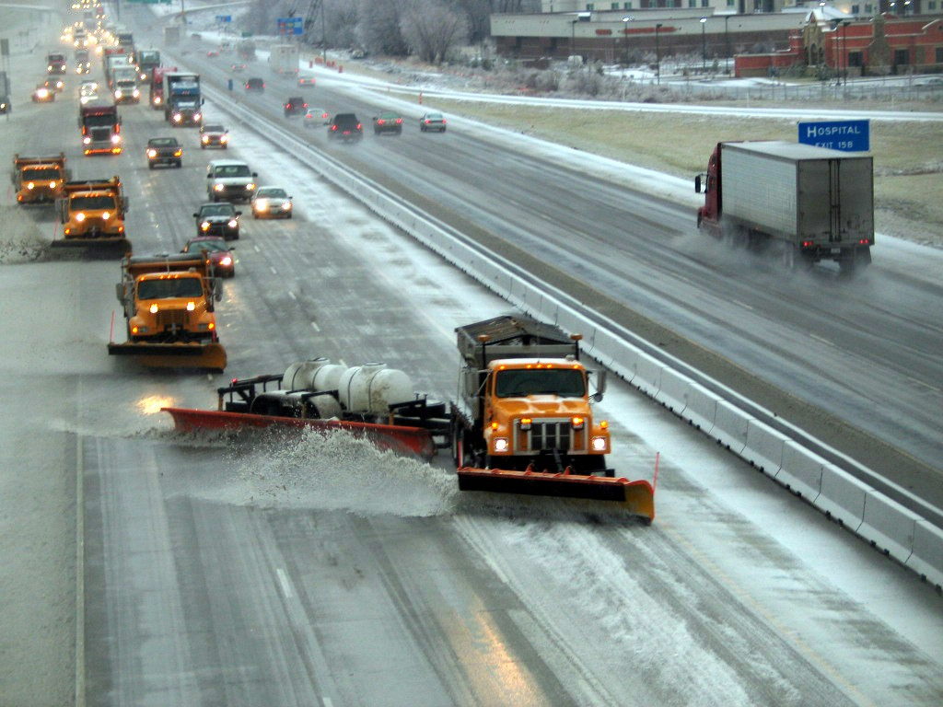
FUTURE APPLICATIONS
Road Maintenance – Where are we losing the road to ice?
When should we paint or repair?

Slide 26
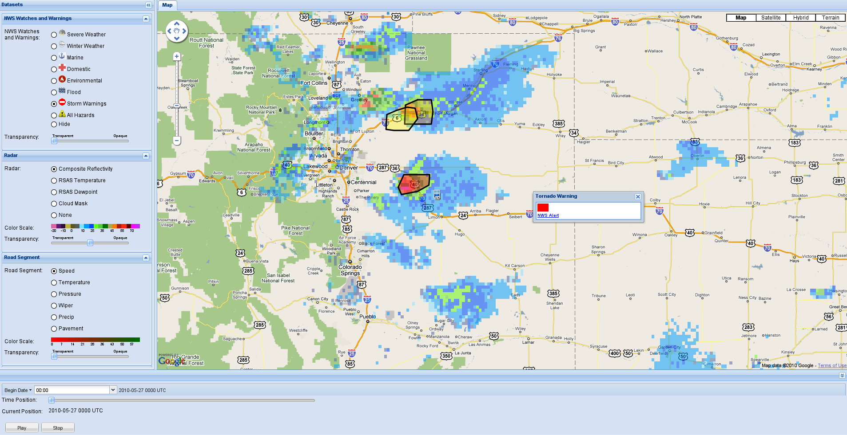
FUTURE APPLICATIONS
Road Maintenance – Where are we losing the road to ice?
When should we paint or repair?
Route Specific Impact Warnings for…
Tornado Warning!
I70 Denver to Limon
Delay Until 3:30pm

Slide 27
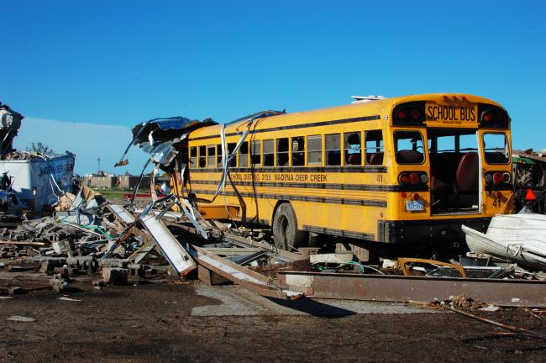
FUTURE APPLICATIONS
Road Maintenance – Where are we losing the road to ice?
When should we paint or repair?
Route Specific Impact Warnings for…
Tornado Warning!
I70 Denver to Limon
Delay Until 3:30pm
School Buses

Slide 28
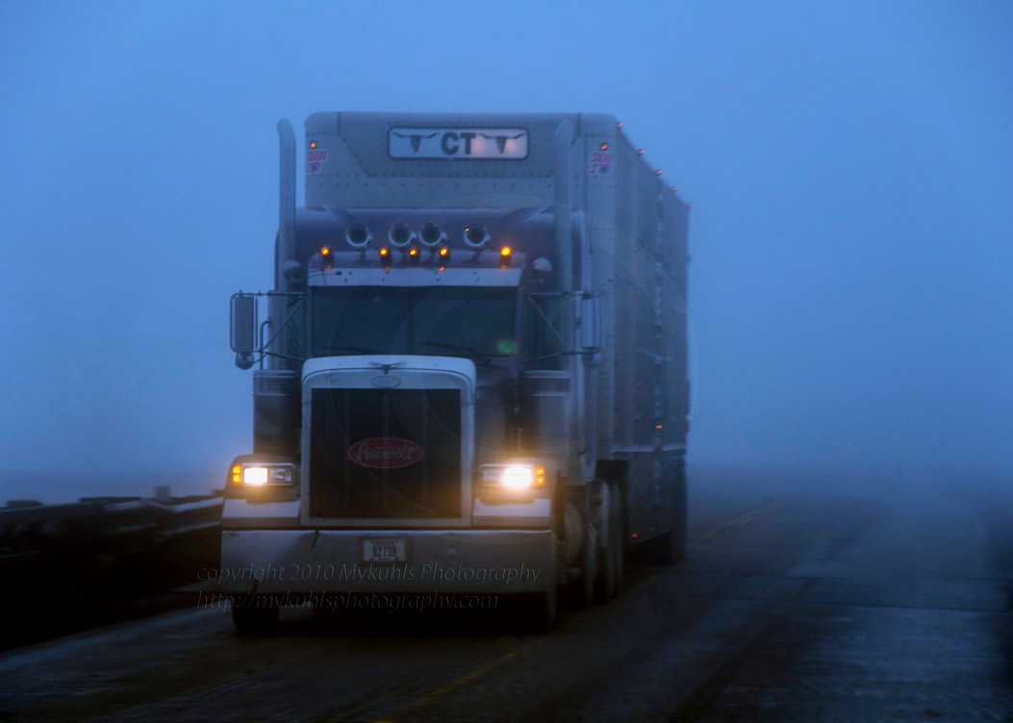
FUTURE APPLICATIONS
Road Maintenance – Where are we losing the road to ice?
When should we paint or repair?
Route Specific Impact Warnings for…
Tornado Warning!
I70 Denver to Limon
Delay Until 3:30pm
School Buses
Truckers

Slide 29
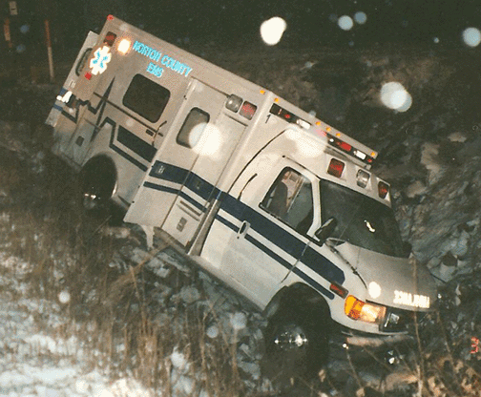
FUTURE APPLICATIONS
Road Maintenance – Where are we losing the road to ice?
When should we paint or repair?
Route Specific Impact Warnings for…
Tornado Warning!
I70 Denver to Limon
Delay Until 3:30pm
School Buses
EMS
Truckers

Slide 30
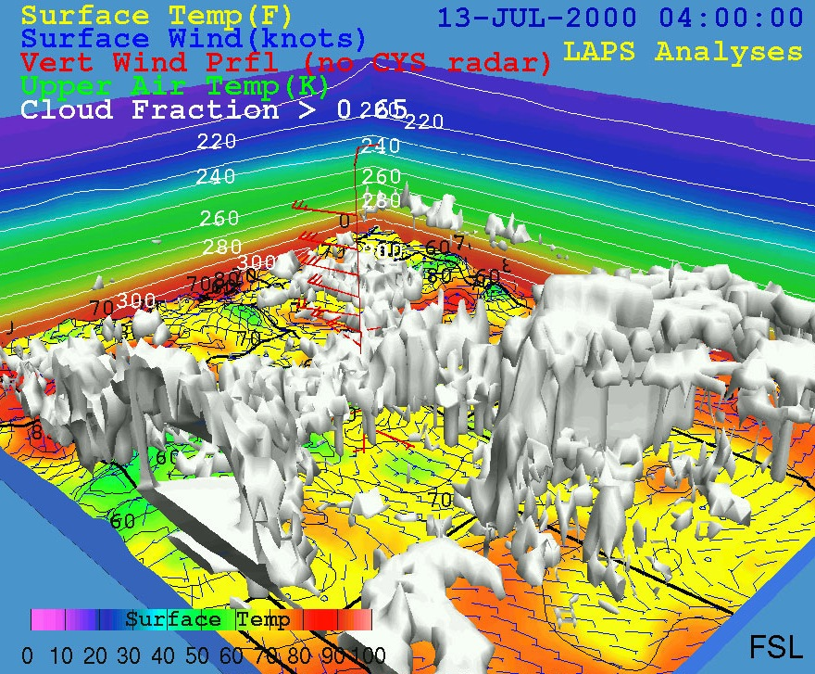
More APPLICATIONS
Numerical Weather Modeling

Slide 31
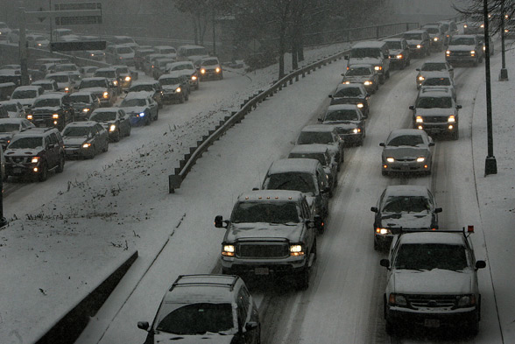
More APPLICATIONS
Numerical Weather Modeling
Traffic Modeling and Alerting

Slide 32
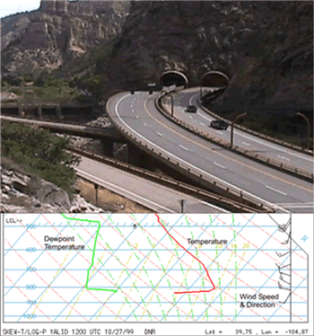
More APPLICATIONS
Numerical Weather Modeling
Traffic Modeling and Alerting
Weather Modeling – complex terrain

Slide 33
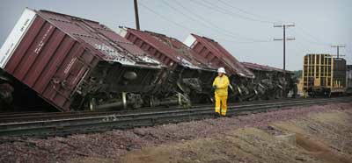
More APPLICATIONS
Numerical Weather Modeling
Traffic Modeling and Alerting
Weather Modeling – complex terrain
Other surface transportation users

